Slide 1
Sorting & Searching
Presented by Jun, Hunter and Dexter

Slide 2
Definition - Dexter
Searching --- is an operation or a technique that helps finds the place of a given element or value in the list. Any search is said to be successful or unsuccessful depending upon whether the element that is being searched is found or not. Some of the standard searching technique that is being followed in data structure is listed below:
Linear Search or Sequential Search
Binary Search

Slide 3
Definition - Dexter
Sorting --- refers to arranging data in a particular format. Sorting algorithm specifies the way to arrange data in a particular order. Most common orders are in numerical or lexicographical order. Some of the standard searching technique that is being followed in data structure is listed below:
Bubble Sort
Insertion Sort
Selection Sort
Merge Sort
Shell Sort
Quick Sort

Slide 4
Binary Search - Dexter
What is it & How it works?
Binary search is a fast search algorithm with run-time complexity of Ο(log n).
This search algorithm works on the principle of divide and conquer.
For this algorithm to work properly, the data collection should be in the sorted form.
It compares the middle most item of the collection. If a match occurs, then the index of item is returned. If the middle item is greater than the item, then the item is searched in the sub-array to the left of the middle item. Otherwise, the item is searched for in the sub-array to the right of the middle item. This process continues on the sub-array as well until the size of the subarray reduces to zero.
Notes:
In computer science, divide and conquer is an algorithm design paradigm based on multi-branched recursion. A divide and conquer algorithm works by recursively breaking down a problem into two or more sub-problems of the same or related type, until these become simple enough to be solved directly.
https://hackernoon.com/what-does-the-time-complexity-o-log-n-actually-mean-45f94bb5bfbf
http://bigocheatsheet.com/
Log2n = k (Definition of definition of logarithm)

Slide 5

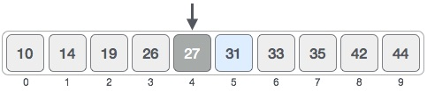

Binary Search - Dexter
Example:
Target --- Looking for 31
Check value of the middle index : 4 [0 + 9 /2] -- 27 match not found and smaller than the target
Hench search in right side the array

Slide 6
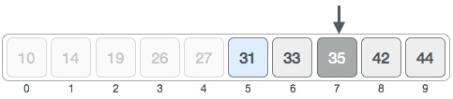

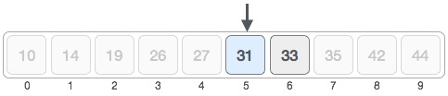
Binary Search - Dexter
Repeat: check value of the middle index : 7 [5 + 9 /2] -- 35 match not found and greater than the target
Hench search the target in the left of the array
Repeat: check value of the middle index : 5 [5 + 6 /2] -- 35 match found and return the index

Slide 7
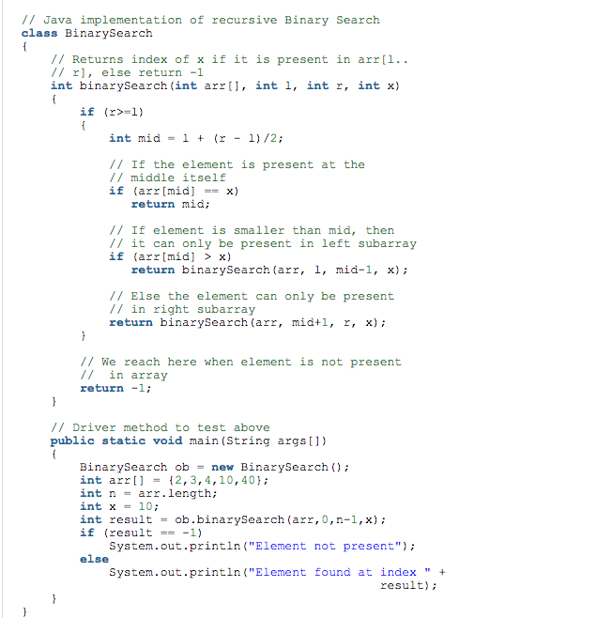
Binary Search - Dexter
How to write in Java:

Slide 8
Selection Sort - Hunter
What is it & How it works ?
Selection sort is a simple in-place comparison-based sorting algorithm.
It has O(n²) time complexity, making it inefficient on large lists, and generally performs worse than the similar insertion sort.
we divide the array in two sub-arrays :Sorted (left)Unsorted (right).
Initially, the sorted subarray is empty and the unsorted subarray is the entire input array.
The algorithm proceeds by finding the smallest element in the unsorted subarray, swapping it with the leftmost unsorted element (putting it in sorted order), and moving the subarray boundaries one element to the right.

Slide 9
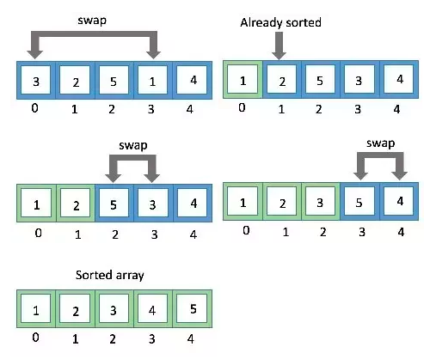
Selection Sort - Hunter
Find the smallest element in the list.
Swap with most left element.
Move to next index...and go on until the end of list.

Slide 10
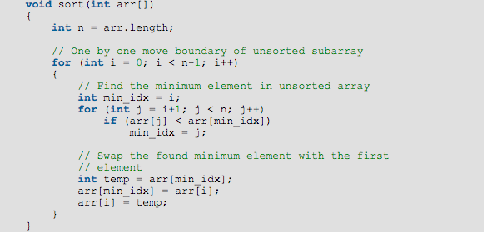
Selection Sort - Hunter
How to write in Java:

Slide 11
Insertion Sort - Jun
What is it & How it works?
Insertion sort is an efficient algorithm for sorting a small number of elements.
It always maintains a sorted sublist in the lower positions of the list. Each new item is then “inserted” back into the previous sublist such that the sorted sublist is one item larger.

Slide 12
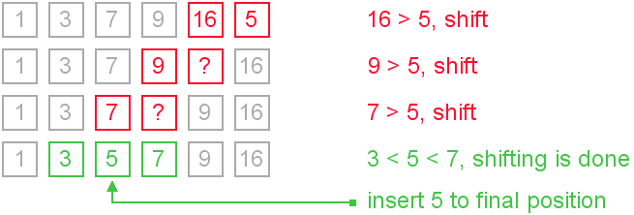
Insertion Sort - Jun
Insertion sort compares two elements. In this case, some elements are already in ascending order. For now, other elements are in sorted sub-list.
Insertion sort moves ahead and compares 16 with 5. And finds that 5 is not in the correct position. So we swap them.
This process goes on until all the unsorted values are covered in a sorted sub-list.

Slide 13
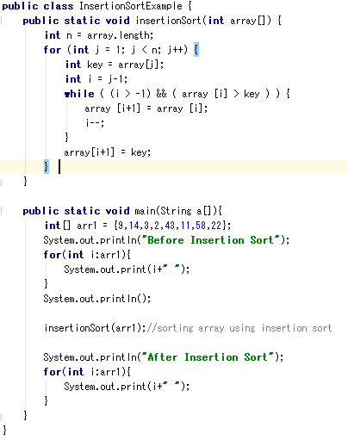
Insertion Sort - Jun
Example how to write in Java

Slide 14
Merge Sort - Hunter
What is it & How it works ?
Merge sort is an efficient and very popular sorting algorithm. It is basically a divide and conquer algorithm just like the quick sort. So the strategy includes divide, conquer and combine.
It divides the array in two equal parts(based on the median).
Each set is individually sorted and the resulting sorted sequence are merged to get a single sorted sequence.
You must note, that the array is divided into two parts till we get individual elements.

Slide 15
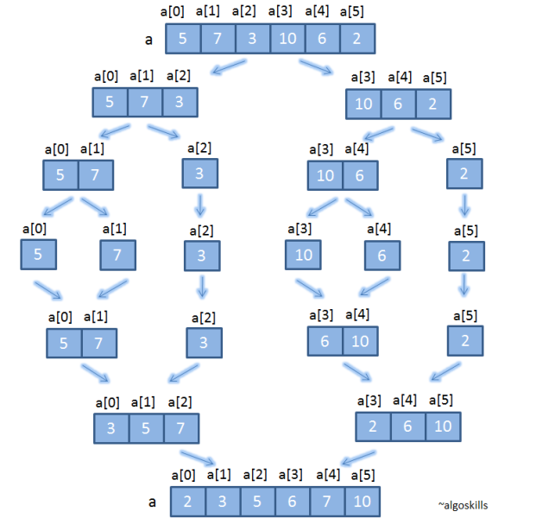
Merge Sort - Hunter
Divide into two equal array until there is only one element left in every part.
starts merging arrays back from (small to large) till the complete array is merged.

Slide 16
Merge Sort - Hunter
How to write in Java:
In the coding part, merge sort is carried out using two important functions i.e. merge and mergesort.
mergesort function: It is used to divide the array into two parts and calls the function merge within itself.
merge function: It is used to combine the two subarrays in correct order given below. This function can also be considered as the heart of the algorithm.

Slide 17
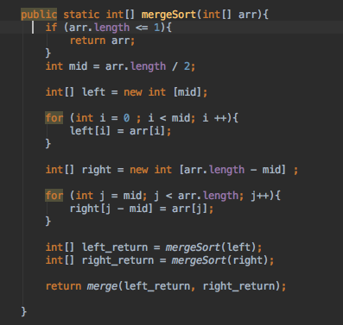
Merge Sort - Hunter
mergesort function: It is used to divide the array into two parts and calls the function merge within itself.

Slide 18
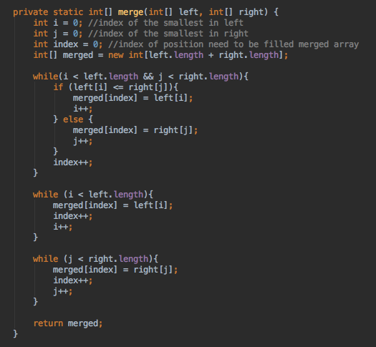
Merge Sort - Hunter
merge function: It is used to combine the two subarrays in correct order given below. This function can also be considered as the heart of the algorithm.

Slide 19
Quick Sort - Jun
What is it & How it works?
QuickSort is a Divide and Conquer algorithm. It picks an element as “pivot “and “partitions” the given array around the picked pivot. There are many different versions of quickSort that pick pivot in different ways.
Always pick first element as pivot.
Always pick last element as pivot (implemented below)
Pick a random element as pivot.
Pick median as pivot.

Slide 20
Quick Sort - Jun
Quick sort partitions an array and then calls itself recursively twice to sort the two resulting subarrays.
The pivot value divides the list into two parts. And recursively, we find the pivot for each sub-lists until all lists contains only one element.
Following animated representation explains how to find the pivot value in an array.

Slide 21
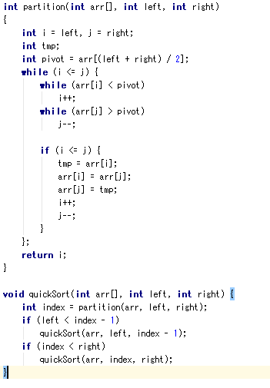
Quick Sort - Jun
Example how to write in Java

Slide 22
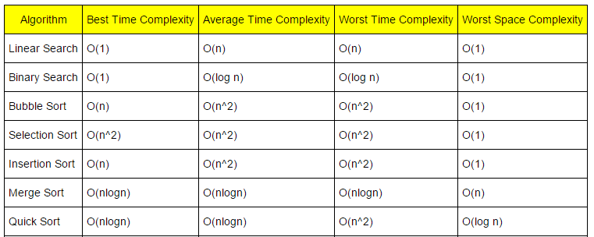
Analysis of each algorithms - Dexter
Comparison chart for each algorithms

Slide 23
Analysis of each algorithms - Dexter
In computer science, the analysis of algorithms is the determination of the computational complexity of algorithms, that is the amount of time, storage and/or other resources necessary to execute them.
Time Complexity & Space Complexity
Time complexity of an algorithm quantifies the amount of time taken by an algorithm to run as a function of the length of the input. Similarly, Space complexity of an algorithm quantifies the amount of space or memory taken by an algorithm to run as a function of the length of the input.

Slide 24
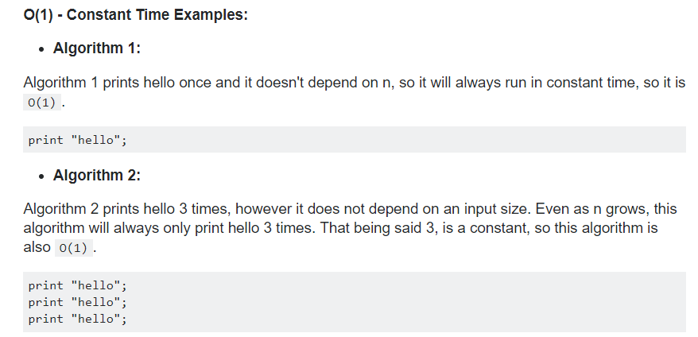
O(1) ? O (n) ? O (log n) ? O (n log n) O (2^n)

Slide 25
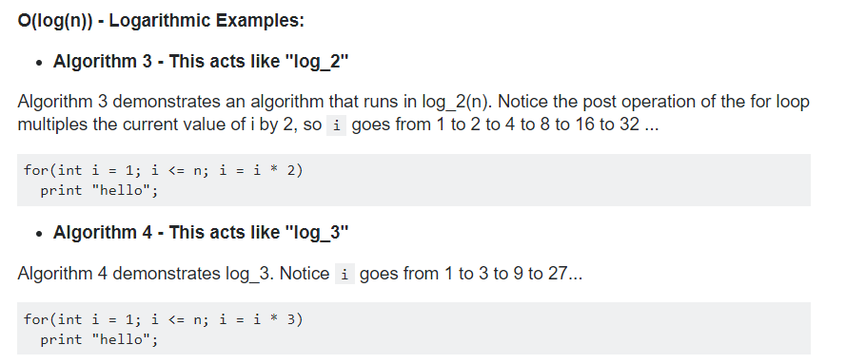
O(1) ? O (n) ? O (log n) ? O (n log n) O (2^n)

Slide 26
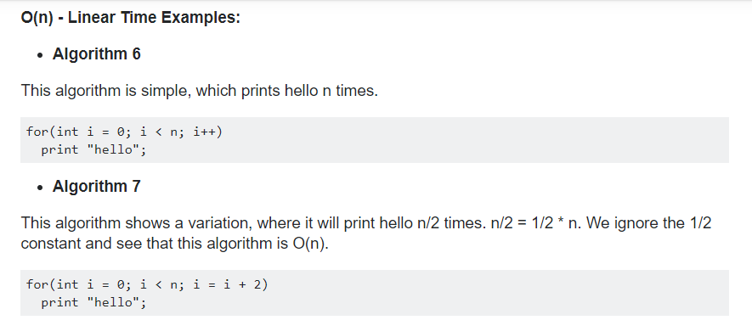
O(1) ? O (n) ? O (log n) ? O (n log n) O (2^n)

Slide 27
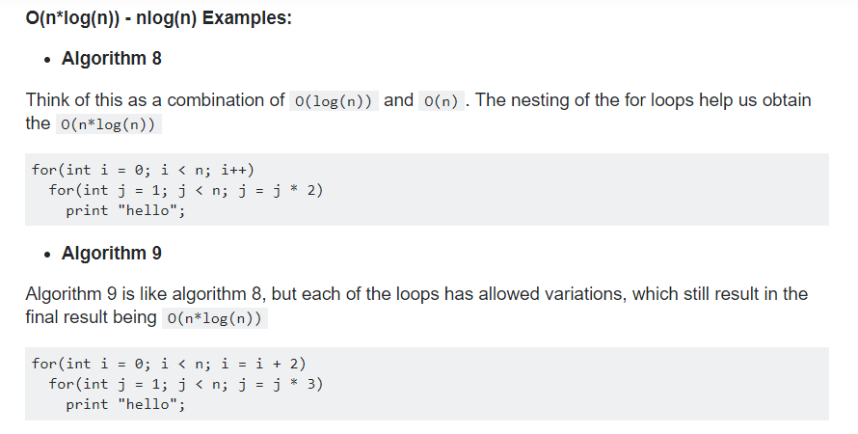
O(1) ? O (n) ? O (log n) ? O (n log n) O (2^n)

Slide 28
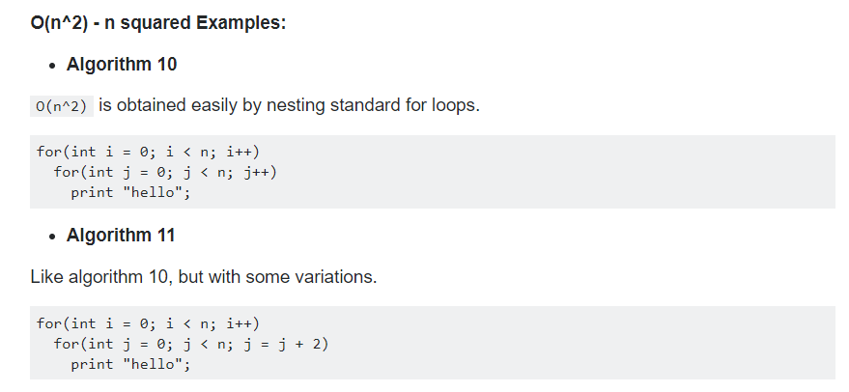
O(1) ? O (n) ? O (log n) ? O (n log n) O (2^n)

Slide 29
This Table again!

Slide 30
What should I choose？
Weight all factors! For example, quicksort is a very fast algorithm but can be pretty tricky to implement; bubble sort is a slow algorithm but is very easy to implement.
To sort small sets of data, bubble sort may be a better option since it can be implemented quickly, but for larger datasets, the speedup from quicksort might be worth the trouble implementing the algorithm.

